Slide 1
Human Sexuality
Mr. Bower

Slide 2
Human Sexuality
So how much really does a baby cost each year? Let’s find out…………
http://www.teenageparent.org/english/costofbaby2B.html

Slide 3


What’s The Difference
Sex and Sexuality are related, but are not the same thing
Sexuality- Everything about you that relates you to, or expresses your maleness or femaleness
Sex- Intimate sexual contact or gender
  EX. Sexual Intercourse or Male/Female

Slide 4
Human Sexuality
Between the ages of 9-13 children go through puberty, which marks the beginning of adolescence
Puberty occurs as a result of the release of hormones
Hormones- chemical substances that help regulate many of your body’s functions.

Slide 5
Puberty
Testosterone – male hormone
Estrogen and progesterone – female hormone
Male and female hormones are responsible for the physical, emotional, and social changes that occur

Slide 6
Physical Changes
The development of the two sex characteristics
-Traits related to a person’s gender
Primary sex characteristics | Secondary sex characteristics
-Directly related to the production of the reproductive cells (gametes) – sperm for males, and ovum for females | -Body hair in both males and females, and the development of breasts and widening of the hips in the females, and the broadening of the chest and the deepening of the voice in males

Slide 7
Concerns over physical changes
As people reach puberty, there is great variation in the size and shape of people of the same age
Girls can be much taller
Boys voices can “crack” – due to an increase in the size of the larynx
Hands and feet may appear large and awkward

Slide 8

Mental changes
By age 6 a child’s brain is 95% of the size it will be when the child is an adult.
The pre-frontal cortex (impulse control) and the cerebrum (cognition) continue to develop through the teen years
You are able to predict the outcomes of many situations – you look at different ways of solving problems
Your ability to think logically, or think things out, increases / can understand someone else’s point of view
New interests will develop and career goals may begin to come into focus

Slide 9
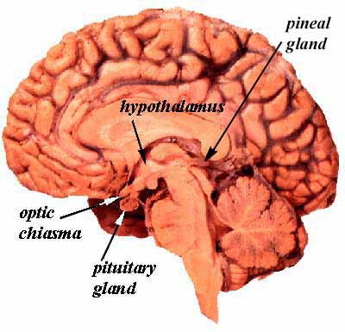
-Master Gland

Slide 10
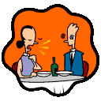
Emotional changes
Strong emotional feelings can come to surface
Emotions and feelings go up and down quickly
May have difficulty in letting others know how they are feeling. This difficulty in communication is a normal part of development!

Slide 11
Male Reproductive System
During puberty, the pituitary gland stimulates the testes to begin producing the male sex hormone, testosterone.
Testosterone causes the production of sperm – male reproductive cell
Production of sperm and the transfer of it to the female’s body during sexual intercourse are the two main biological functions of the male reproductive system

Slide 12
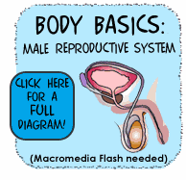
Male reproduction system
Click here to see the male reproductive system

Slide 13
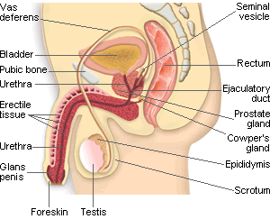

Slide 14
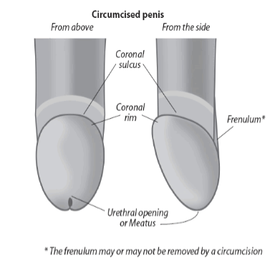
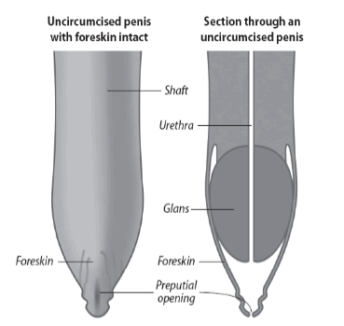
At birth, the tip of the penis is covered with a fold of skin called Foreskin
In the United States Circumcision (the surgical removal of the foreskin) is common although worldwide up to 80% of the population have intact penis's.

Slide 15
Male Reproductive System is made up of both internal and external organs
External organs:
1. testes (testicles) – are two small glands that produce sperm. Testes hang outside of the body in a sac called the scrotum - This sac protects sperm by keeping the testes at a temperature slightly below normal

Slide 16

Male Reproductive System
Penis – external sex organ in which the sperm is delivered to the females body.
Composed of spongy tissue that contains many blood vessels. As a result of increased blood flow, the penis can become enlarged and erect.

Slide 17
Male Reproductive System
During sexual arousal, a series of muscular contractions, known as ejaculation, can occur.
Semen – a thick fluid containing sperm, and other secretions from the male reproductive system is propelled from the penis
Sperm- The male gametes, or reproductive cells
Foreskin a retractable fold of skin that covers the glans of the penis—called also prepuce
Circumcision – the surgical removal of the foreskin

Slide 18

Care of the reproductive system
Includes cleanliness, protection, and self-examination
A male who is not circumcised must practice proper hygiene
Avoid wearing clothing that is too tight
Wear a protective or supporter during strenuous exercise
Practice abstinence
Perform a monthly self exam of the testes to check for any thickening or lumps

Slide 19
Testicular Self Exam
Why do I need it?
  Testicular cancer (TC) is the most common type of cancer affecting men between the ages of 15 and 35 years old--but it can strike any male, any time.
  Testicular cancer is almost always curable if it is found early.
http://www.acor.org/TCRC/, http://medlineplus.gov/ , http://kidshealth.org/teen/

Slide 20
Problems of the male reproductive system
1. Hernia –Inguinal hernia-Inguinal hernias occur when soft tissue — usually part of the intestine — protrudes through a weak point or tear in your lower abdominal wall. The resulting bulge can be painful — especially when you cough, bend over or lift a heavy object.
2. Sterility – condition in which a person is unable to reproduce.
can be a result of producing too few sperm. This can be caused from environmental hazards that damage the sperm making process - exposure to X rays, radiation and
lead from motor exhaust
Can also be caused from temperature change, exposure to certain chemicals, smoking, disease.

Slide 21
3. Enlarged prostate gland – can enlarge for reasons such as infection, a tumor, or old age. When the gland enlarges, it tends to squeeze the urethra, resulting in frequent or difficult urination
4. Testicular torsion –twisting of testes so that blood vessels leading to the testes also twists, cutting off the blood supply.

Slide 22
5. Cancer of the Prostate – often a cancer site of older men.
6. Cancer of the testes - occurs most frequently in males between the ages of 15 and 35.
Hard lumps, or nodules , on the testes may be a sign of cancer. There may or may not be pain associated with the lumps.

Slide 23
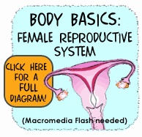
Female reproductive system
Click here to view female reproductive system

Slide 24
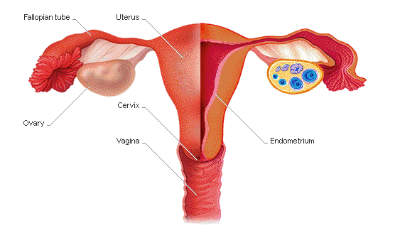
FEMALE REPRODUCTIVE SYSTEM

Slide 25
3. Fallopian tubes – two small tubes that carry a released egg from the ovary to the uterus. When an egg is released from the ovary, it moves into the fallopian tubes and finger like projections draw the egg into the uterus.
*If intercourse occurs during the time there is an egg in the fallopian tube, sperm may unite with the egg and fertilization occurs.

Slide 26
4. Uterus (womb) is a small, muscular, pear-shaped organ, about the size of a fist. The fertilized egg will develop and grow in the uterus. The uterus has layers of tissue and a rich supply of blood to protect and nourish the developing fetus.
*the base of the uterus is called the cervix. It expands during childbirth to allow the passage of the baby

Slide 27
Menstruation
If the ovum does not become fertilized, the lining of the uterus breaks down and is passed out of the vagina. This process is called menstruation
Usually lasts 3-5 days
Menstrual cycle, which is the time from the beginning of one menstrual cycle to the onset of the next, is usually a 28 day cycle
Onset – usually between the ages of 10 – 15
Can be very irregular at first
Can also by affected by poor nutrition, high activity level, stress and illness

Slide 28
Menstrual cycle
Click here to view menstrual cycle

Slide 29
Problems of the FRS
Menstrual cramps –
Usually mild, lasting for several hours
Heating pad, over the counter medication, and light exercise can help
Premenstrual Syndrome (PMS) a variety of symptoms that can occur several days to two weeks before the menstrual period.
Symptoms – nervous tension, anxiety, irritability, mood swings, fatigue, bloating

Slide 30
Maintaining Reproductive Health
Includes cleanliness and self-examination
Bathe Regularly- shower or bathe daily
Practice abstinence
Have regular medical exams

Slide 31
Problems that can cause infertility
Blocked fallopian tube - leading cause of female infertility.
Pelvic Inflammatory Disease [ an infection of the fallopian tubes, ovaries and surrounding areas in a woman’s pelvis. It can damage the reproductive organs and is usually caused by sexually transmitted diseases.
Endometriosis – uterine tissue grows outside the uterus, often appearing on the ovaries, fallopian tubes in in the abdominal cavity

Slide 32
Other reproductive disorders
Cervix, uterus and ovaries are common sites of cancer. Cervical cancer is detected through a Pap test, a test in which samples of cells are taken from the cervix by a doctor. All sexually active females should have a yearly Pap smear and all women from the age of 18 and older should also have a yearly Pap smear

Slide 33
Breast self-examination
Is an important habit for females to develop
Should be done once a month, about a week after the start of their menstrual period
Should check for anything unusual, such as any discharge from the nipples, lumps or mass under the skin

Slide 34
Breast Self Exam
Why do I need it?
  All women are at risk for getting breast cancer. As you get older, your risk increases. Assuming you live to age 90, your risk of getting breast cancer over your lifetime is about 14%. That might sound scary, because it means that an average of about one out of every seven women will get breast cancer over a 90-year life span.
  You can also look at it another way: A 14% risk means there's an 86% chance that you WON'T get breast cancer.
http://www.breastcancer.org/, http://medlineplus.gov/, http://kidshealth.org/teen/

